Slide 1
Customer Segmentation Retail Banking
Fintech Start-up

Slide 2

What is Customer Segmentation?
Process of grouping consumers who share similar characteristics and needs in organised categories.
This approach of grouping, streamlining and targeting customers is a sound way of contacting them with relevant information and offers.
Customer segmentation data allows for better understanding of the customers, rather than seeing them as one homogenous group

Slide 3

What are the benefits?
Customer segmentation provides an insight into customer behaviour, purchasing habits, areas of competitive advantage, and relevant data for improving campaigns. Targeting customers efficiently would require segmentation. By building relationships with customers through targeted marketing, retention rates will remain high and keep marketing campaigns profitable.

Slide 4

How does it work?
When conducting customer segmentation analysis, customer groups that have similar characteristics are grouped together. They can be divided into segments based on a wide range of characteristics and criteria. These can be socio-demographic, geographic and behavioural characteristics.

Slide 5
Project aim
To analyse home loans in the US
Explore the highest loan states
Observe age, geographical and behavioural segmentation
Suggest recommendations for targeted marketing

Slide 6
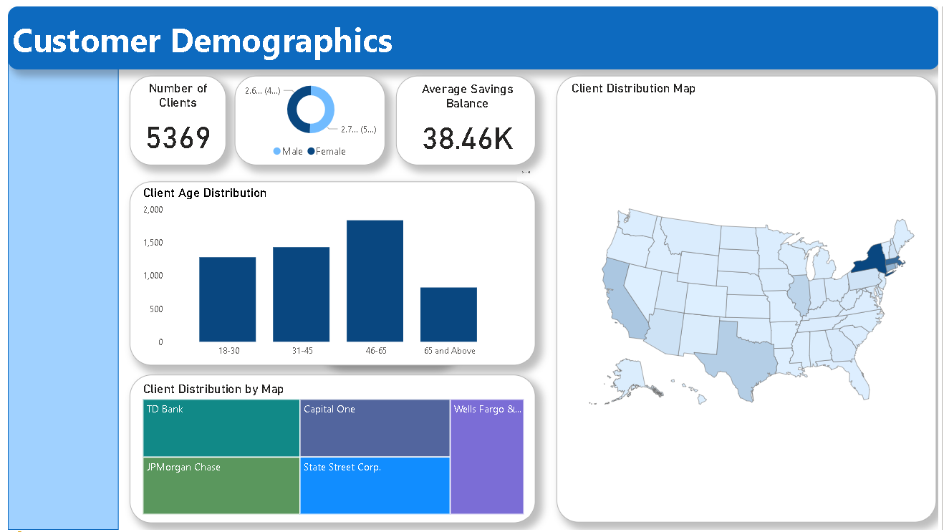

Slide 7
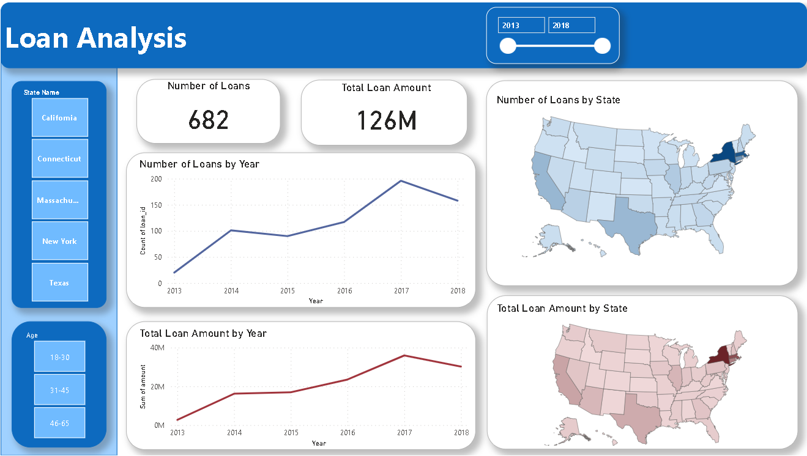

Slide 8
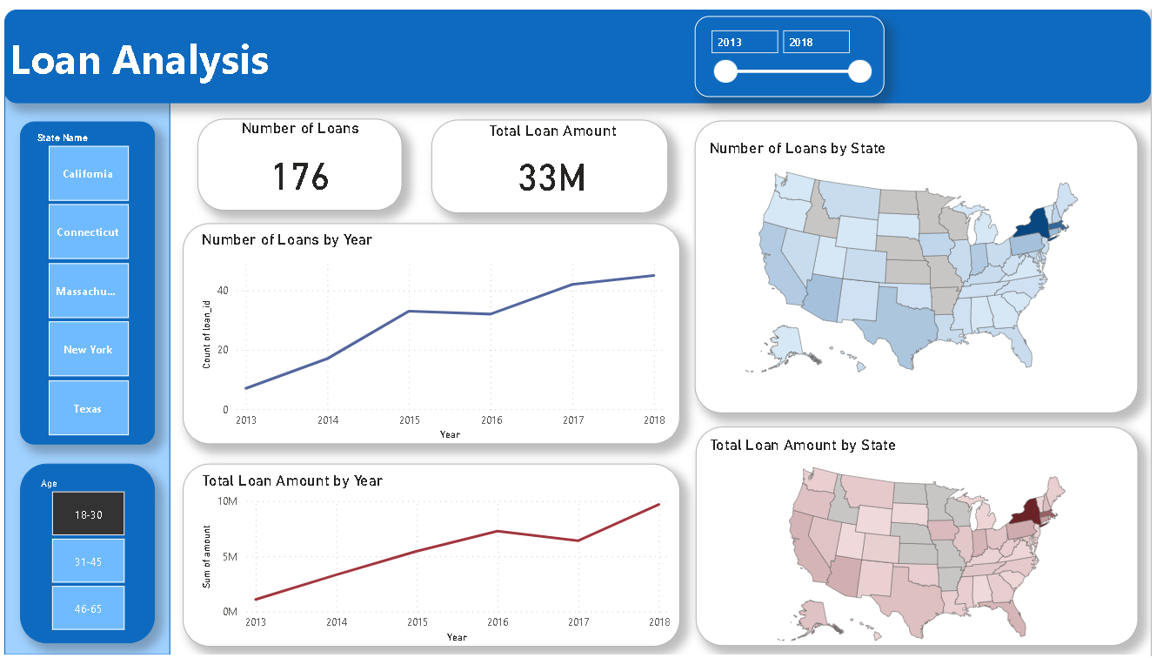

Slide 9
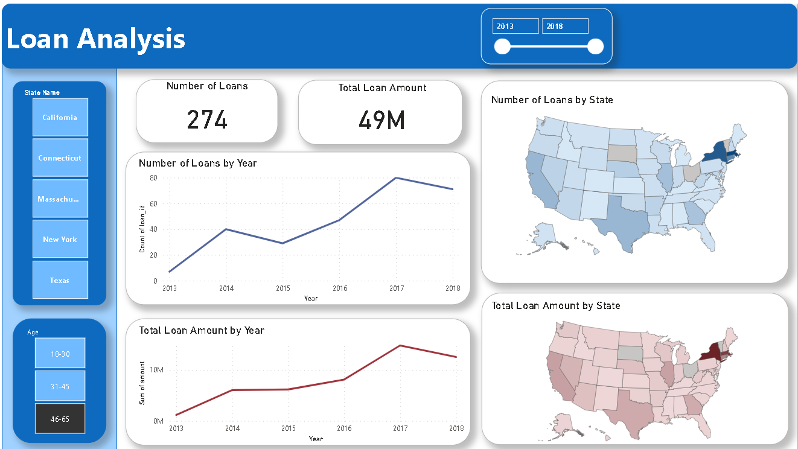

Slide 10
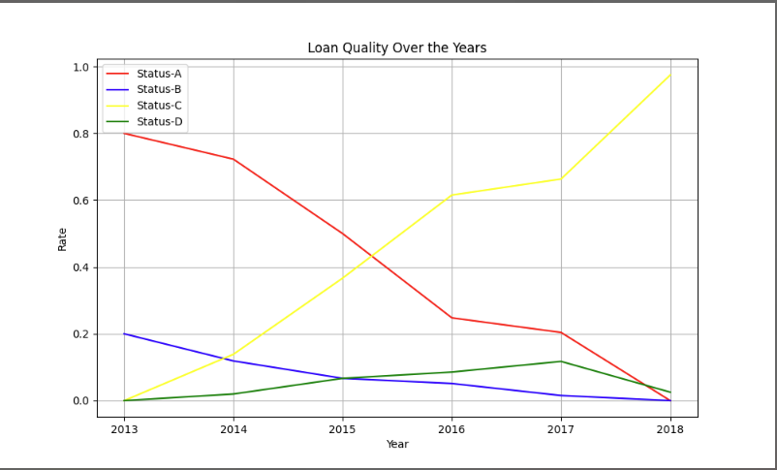

Slide 11
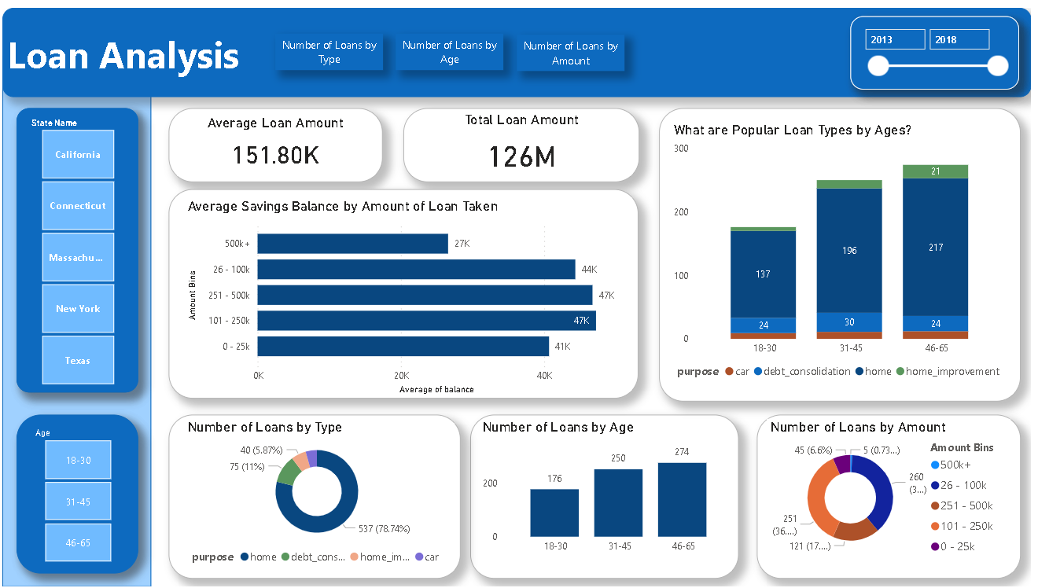

Slide 12
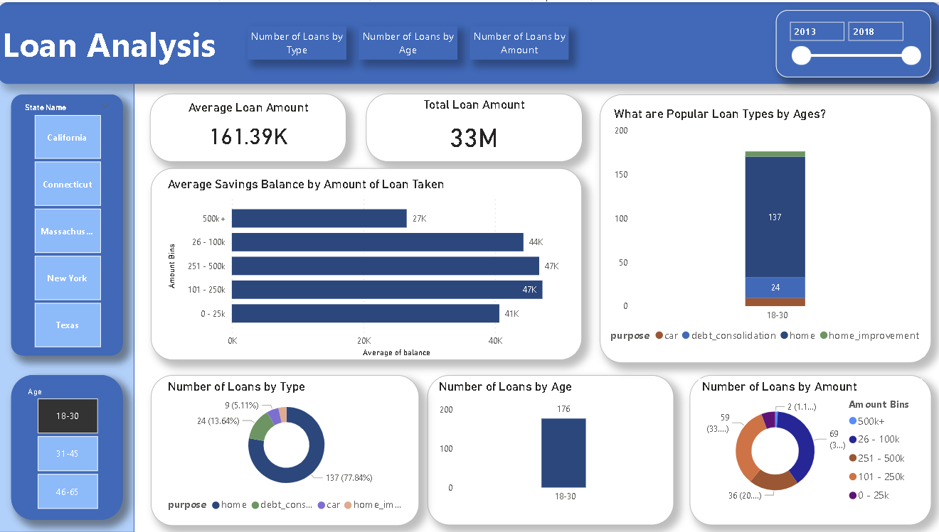

Slide 13
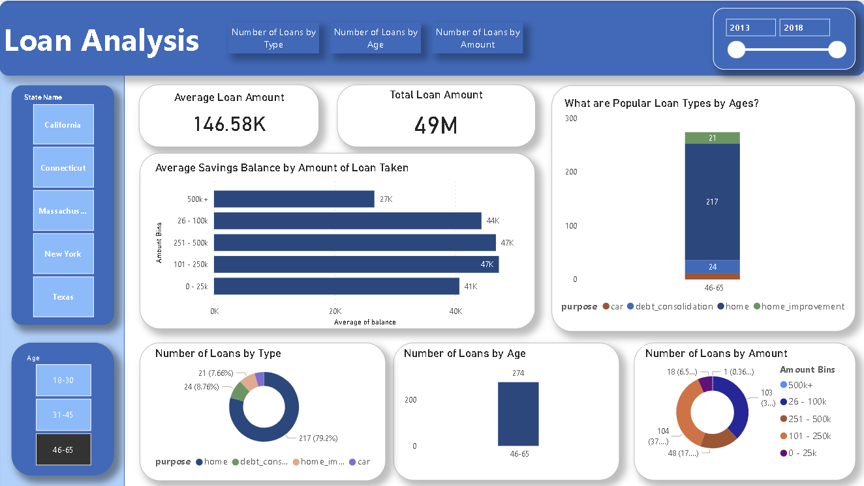

Slide 14
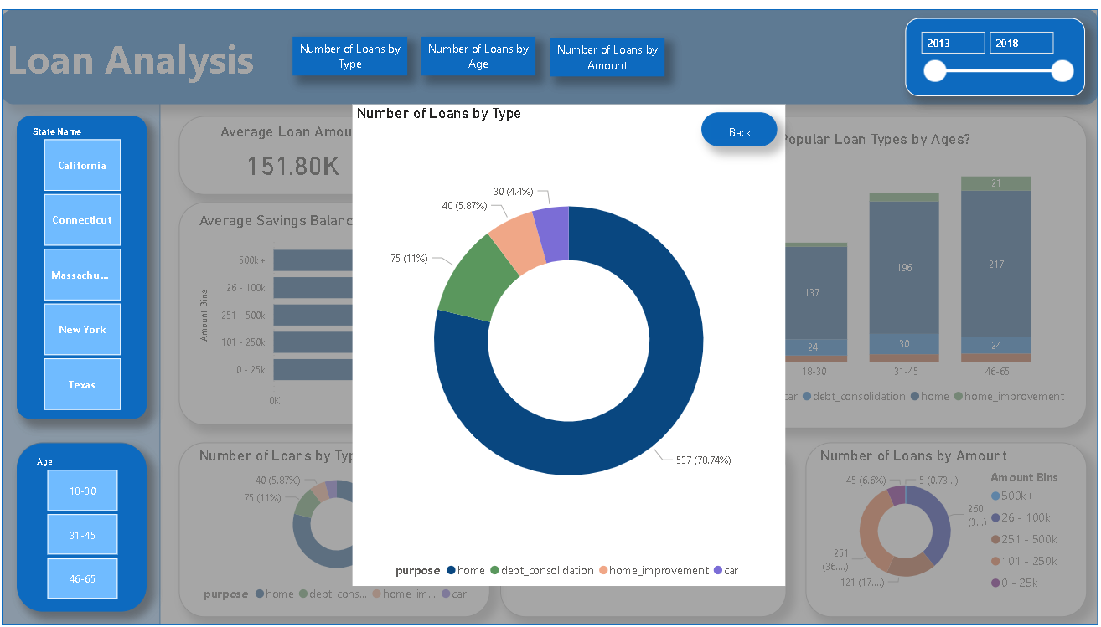

Slide 15
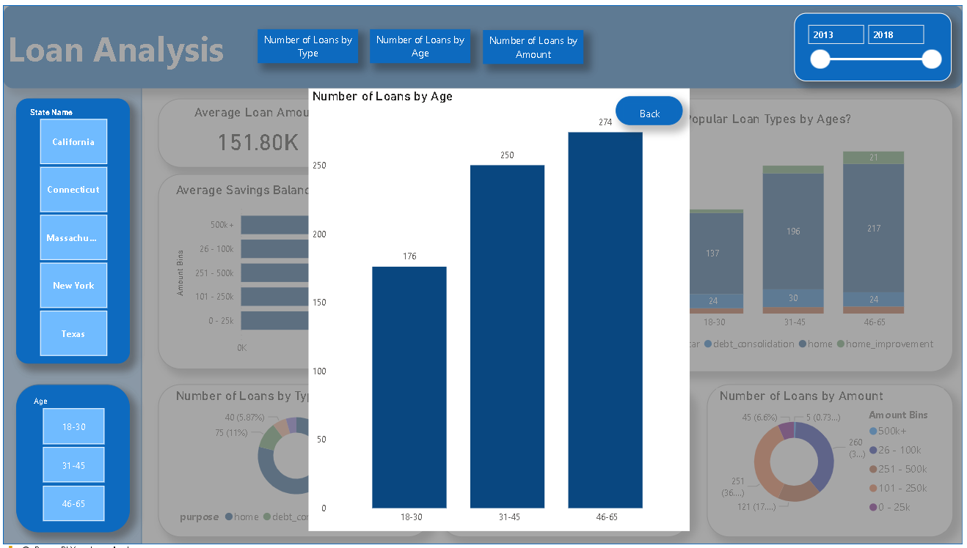

Slide 16
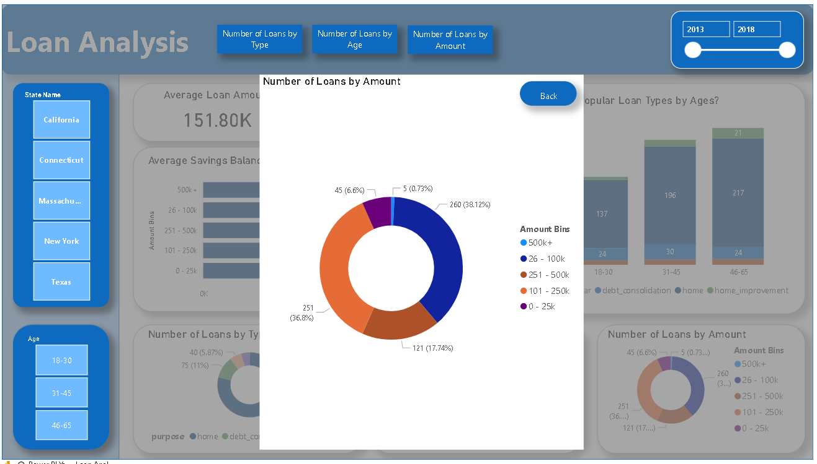

Slide 17
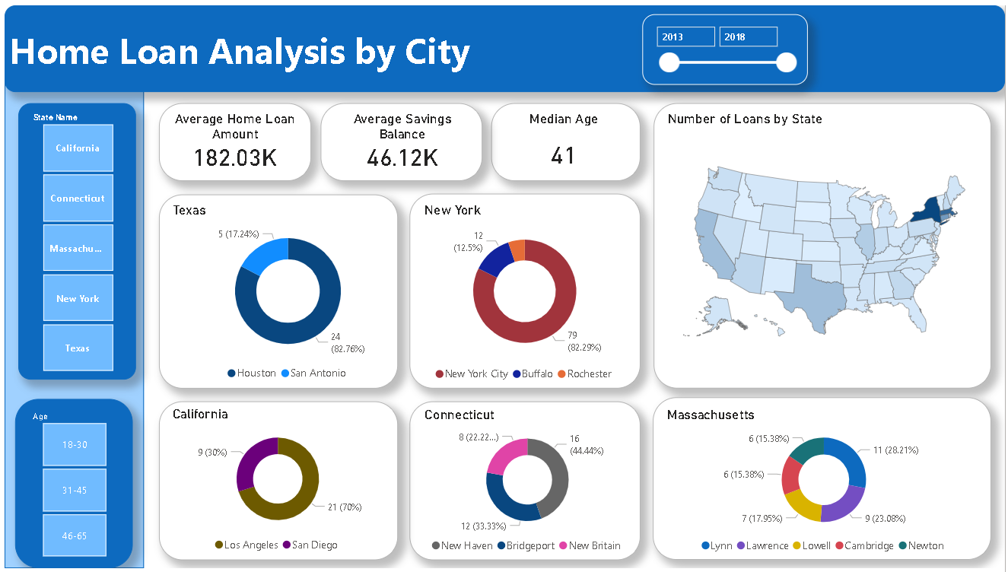

Slide 18
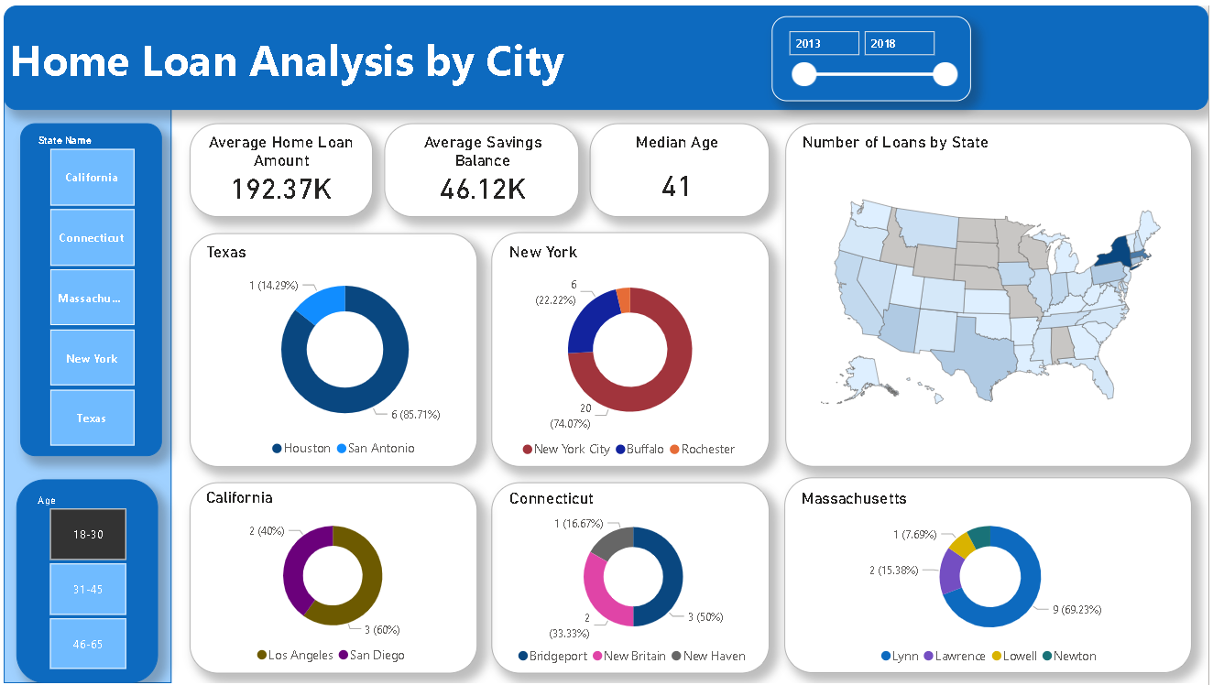

Slide 19

Our Recommendations
Social media
Billboards
Commercials
Emails from banks
The above points will be tailored to each state

Slide 20
CONCLUSION
The majority of loans were for mortgages
Median age for mortgages is 41 years old
Savings for 41-year-olds is $46,000
Average loan amount was just over $182,000
Texas, New York and California have the highest concentration of loans in their respective biggest city as this is where most opportunities and industries are based
In Massachusetts and Connecticut, the loans in cities are more spread out as its more for families

